Slide 1
Car Rental Management System
Anushka Rajesh Darade | 002734159
Harish Kumar Vaithyan Nandhagopu | 002766063
Karthik Prakash | 002728828
Sudharsan Ragavendhiran Anuradha | 002783355
Barathi Sridhar | 002724505
Github_Repository

Slide 2
Problem Statement:
Increased need for car rentals due to the rise in the number of cars in the city.
Development of a car rental system to provide customers with easy search and reservation options.
Providing rental companies and owners with efficient fleet and reservation management.
Contributing towards the reduction of traffic congestion and pollution in the city by encouraging car rentals over ownership.

Slide 3
Our Objective:
Real-time search and reservation feature for customers.
Fleet and reservation management system for rental companies.
Analytics and reporting tools for rental companies to optimize their strategies.
Reservation tracking and modification options for customers.
Cancellation options for customers.
Focus on ensuring security and confidentiality of customer information.
Emphasis on ease of use and user-friendliness.

Slide 4
Proposed Solution:
The Car Rental System enables customers to reserve vehicles from any location.
Customers need to fill out their personal information to provide it to the application.
The customers can reserve a car after creating an account on the website.
The proposed system is a fully integrated, online system that automates manual processes effectively and efficiently.
The automated method allows customers to fill in their specific needs related to the type of car they want to rent and its location.
The primary goal of this system is to develop a website where customers can book cars and request services from anywhere in the world.

Slide 5
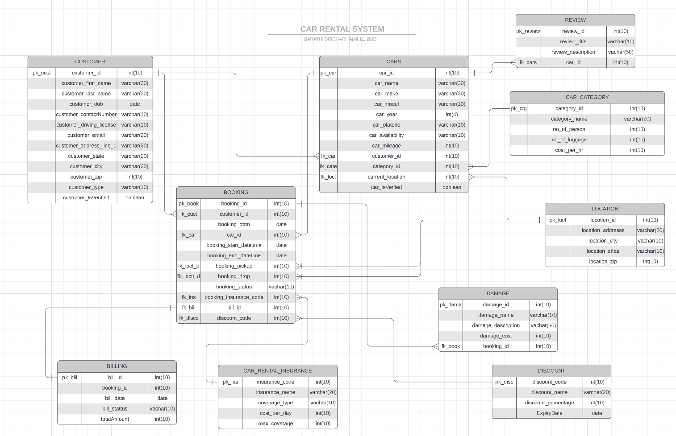

Slide 6
Tables
DISCOUNT: Stores discount code, discount name and expiry date available.
LOCATION: Holds address, city, state and zipcode.
INSURANCE: Contains different types of insurance and descriptions.
CUSTOMER: Contains customer’s personal and contact details and type of customer.
CARS: Holds different car types, customer id, category, location and availability.
BOOKING: Stores account information and customer associations.
CAR_CATEGORY: Stores details of car i.e. no. of people, cost per hour.
REVIEW: Contains review details, and car association.
DAMAGE: Stores damage details of the booking and descriptions.
BILLING: Holds booking id and total cost associated with it.

Slide 7
Views
CAR_AVAILABLE: Lists all the cars that are available.
INSURANCE_AVAILABLE: Lists all available insurances.
BOOKING_PENDING: Aggregates daily transactions by type, excluding failed transactions.
BOOKING_COMPLETED: Lists all completed bookings.
BOOKING_CANCELLED: Lists all completed bookings.
DISCOUNT_AVAILABLE: Lists all available discount coupons.
ECONOMY_CAR_AVAILABILITY: Lists all Economy Cars available in the system.
COMPACT_CAR_AVAILABILITY: Lists all Compact Cars available in the system.
MIDSIZE_CAR_AVAILABILITY: Lists all Mid-Size Cars available in the system.
FULLSIZE_CAR_AVAILABILITY: Lists all Full-size Cars available in the system.
LUXURY_CAR_AVAILABILITY: Lists all Luxury Cars available in the system.
CAR_TRIP_DAMAGE: View for cars that have more than one trip and are involved in damage.
PREFERRED_CAR_TYPES: Type of car which is favoured more in a month.
REVENUE_REPORT_VIEW: Displays the Revenue Report generated in a particular month along with cancelled and completed bookings.
CAR_UTILIZATION: View for car utilization based on number of bookings.
BOOKING_STATUS_REPORT: Booking status report including booking count grouping by booking status .
DAMAGE_REPORT: Displays damage report with count of total damages.
CAR_MONTHLY_TRANSACTION: Display the monthly transaction for all cars .

Slide 8
Triggers
The "bill_insert_trigger" sets the initial status of a new row in the "billing" table to "unpaid" by updating the "bill_status" column of the newly inserted row using the ":NEW" keyword.
The "set_booking_status_pending" sets the initial status of a new row in the "booking" table to "pending" by updating the "BOOKING_STATUS" column of the newly inserted row using the ":NEW" keyword.

Slide 9
Procedures
Add_booking: The "add_booking" procedure adds a booking record for a customer for a specified car, time period, pickup and drop location. It performs various checks and updates the car availability status accordingly.
Cancel_booking: This PL/SQL procedure cancels a booking by updating the booking status to 'CANCELLED' and the corresponding car availability to 'Available'. It takes in a booking ID as input parameter.
Complete_booking: This is a procedure to complete a booking by updating the booking status, generating a new bill, and updating the car availability. It also includes an exception block to handle errors.

Slide 10
Procedures
Add_car: The "add_car" procedure checks if the license plate number already exists in the "cars" table and raises an error if it does. If the license plate number is unique, the procedure inserts the new car record into the table with the provided parameters.
Add_customer: This is a PL/SQL procedure called "add_customer" that adds a new customer record to the "customer" table. It takes in various parameters such as first name, last name, driving license, contact number, and email, and checks if the customer already exists before adding the record.
Update_customer_verification: This is a PL/SQL procedure called "update_customer_verification" that updates the verification status of a customer in the "customer" table. It takes in the customer ID as a parameter and sets the customer_isverified column to 'T'.

Slide 11
PACKAGES
Booking_package: Contains procedures and functions to manage customer actions, such as car pickup location, update booking cars like car availability , booking status and billing.

Slide 12
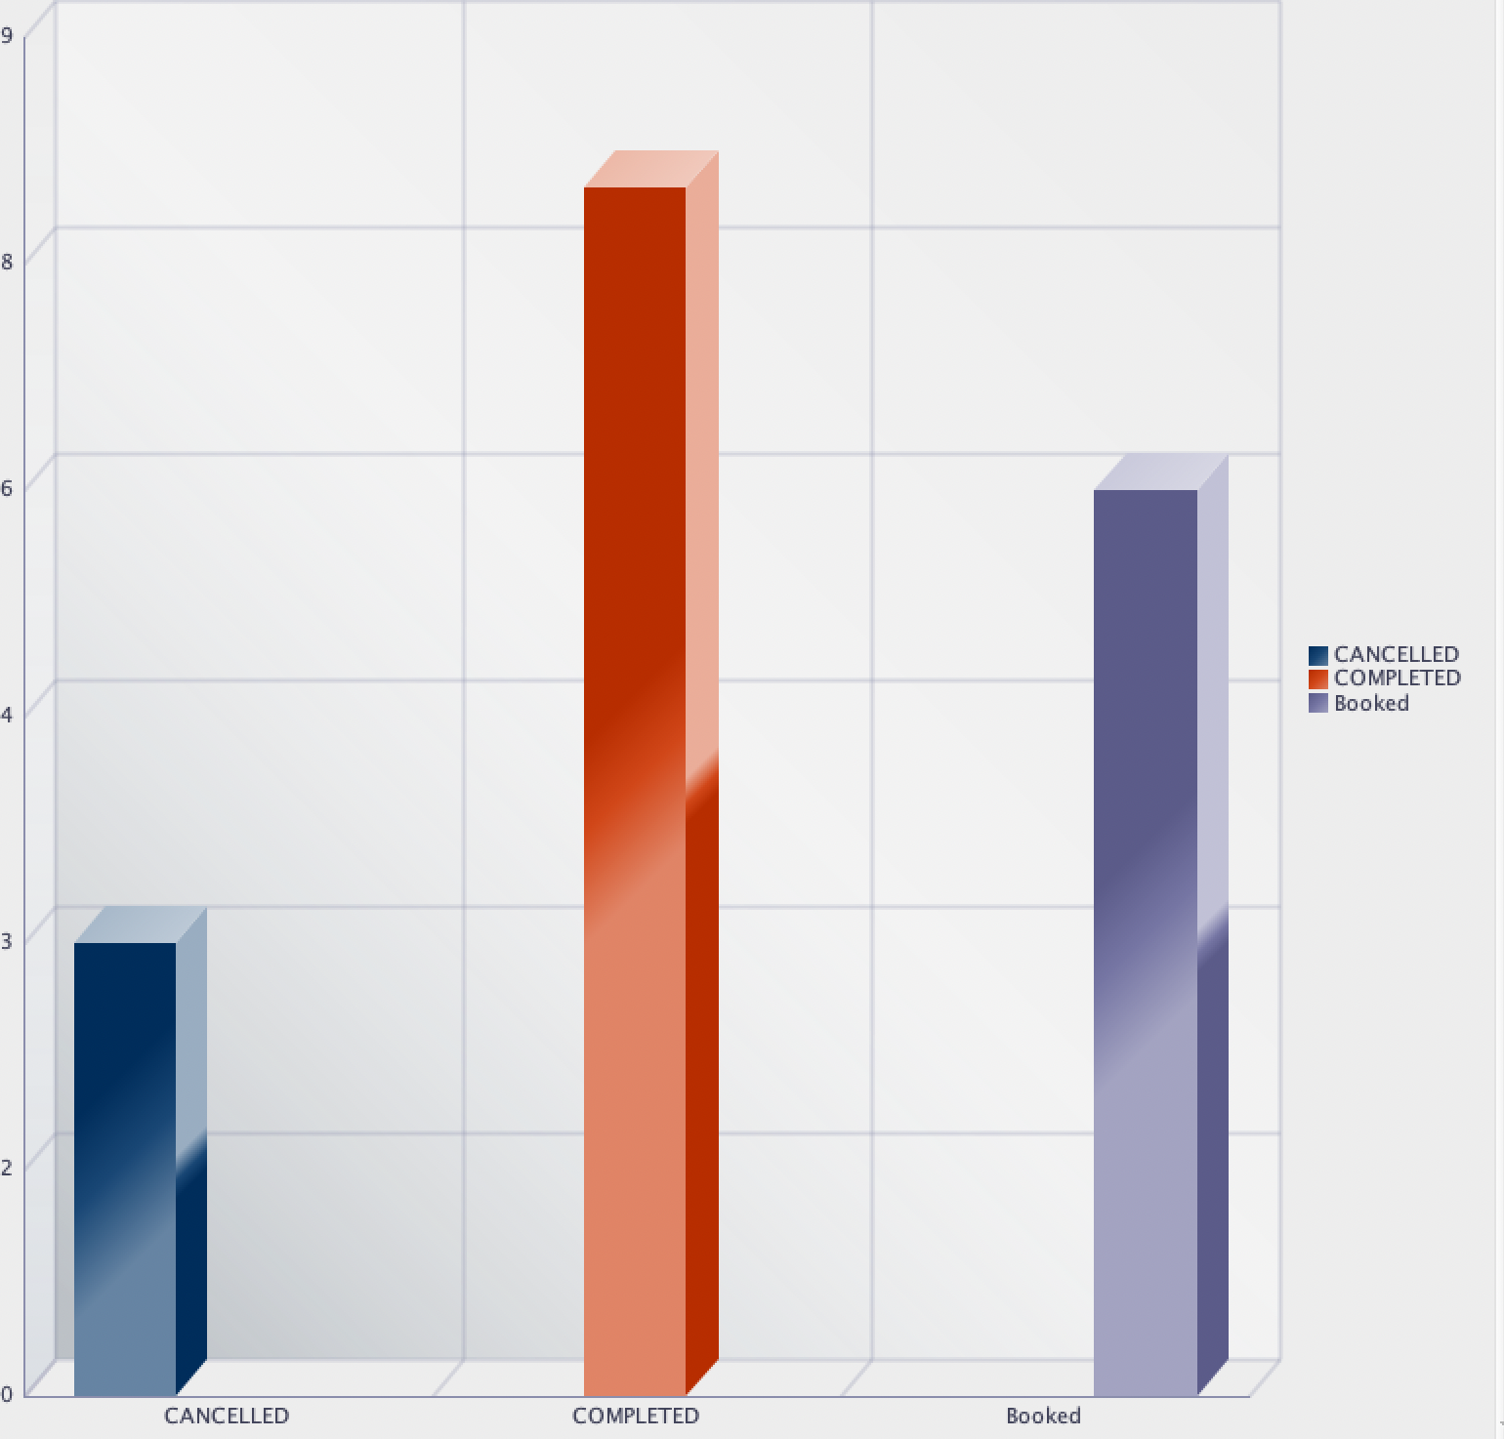
Booking Status Report:
It provides a clear and concise summary of the booking data and allow stakeholders to quickly understand the number of bookings associated with each booking status.

Slide 13
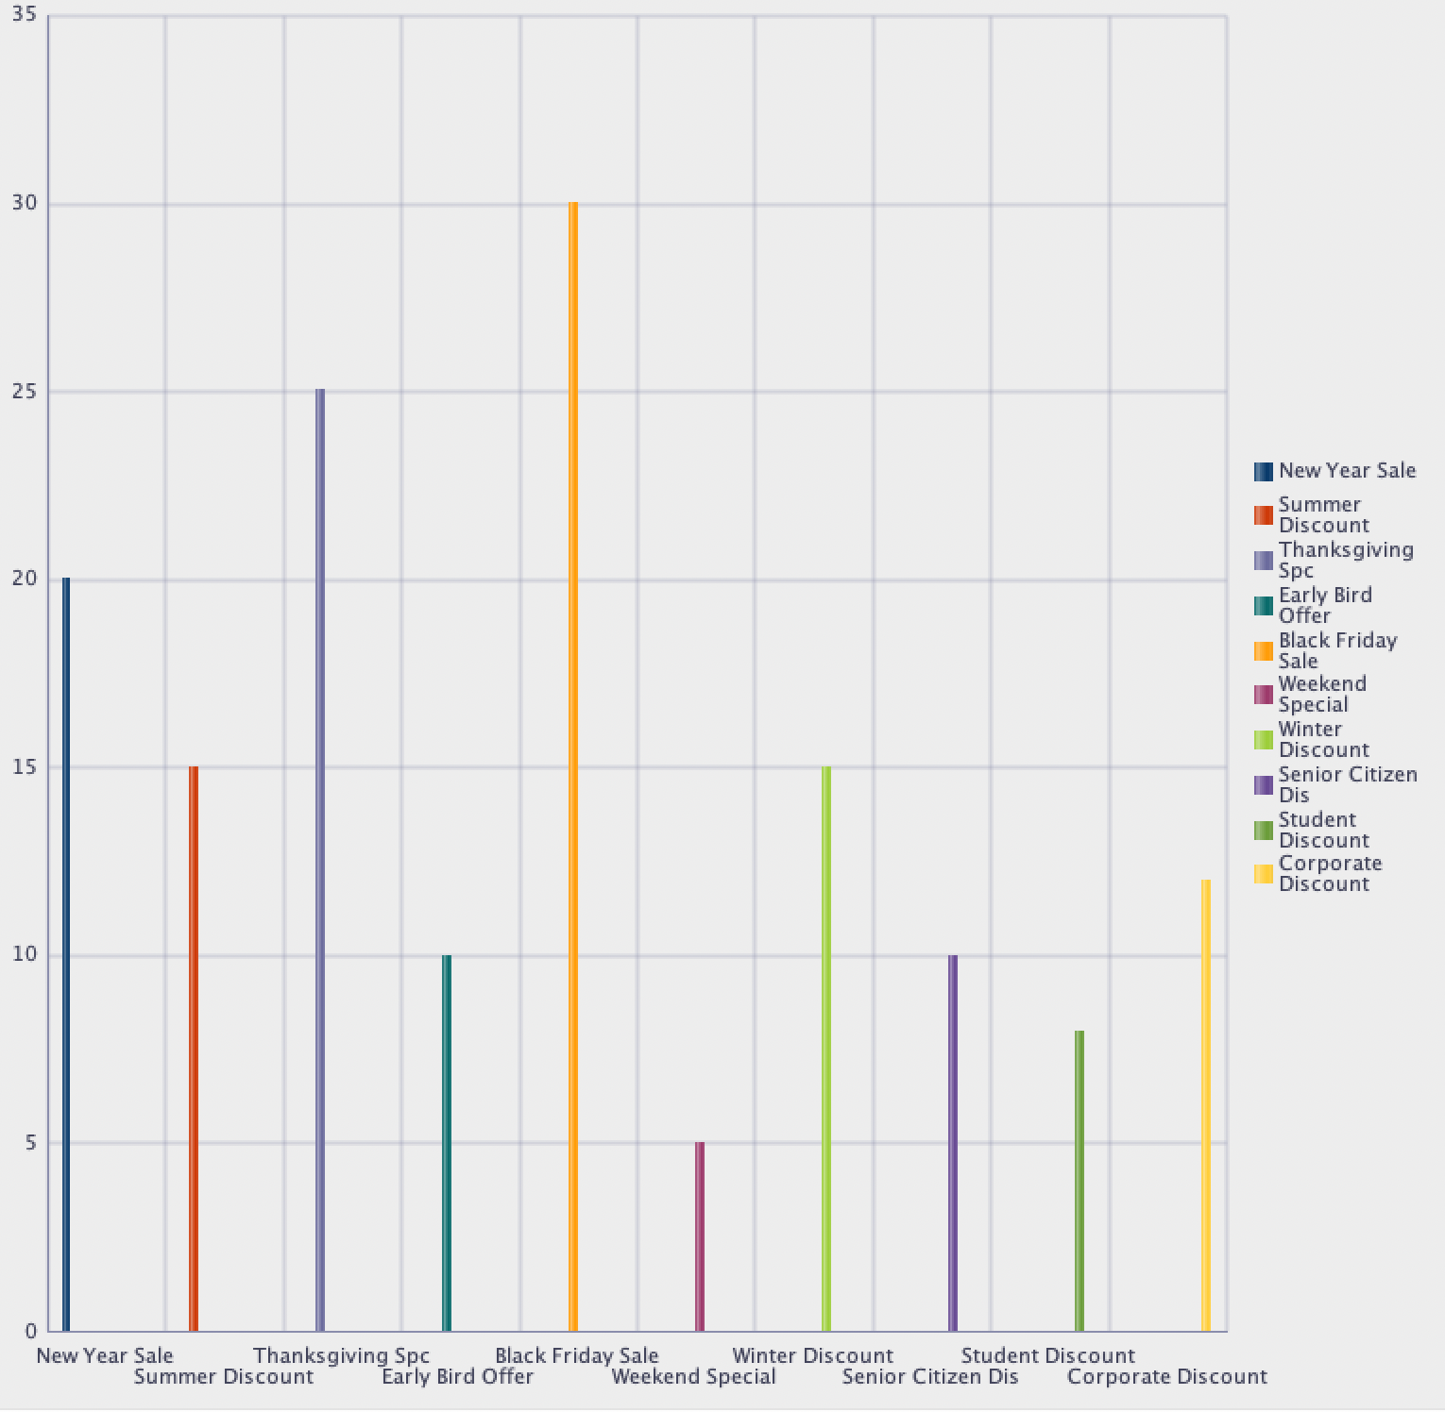
Discount Report:
It provides a summary of the which discount coupon is famous among the customer.

Slide 14
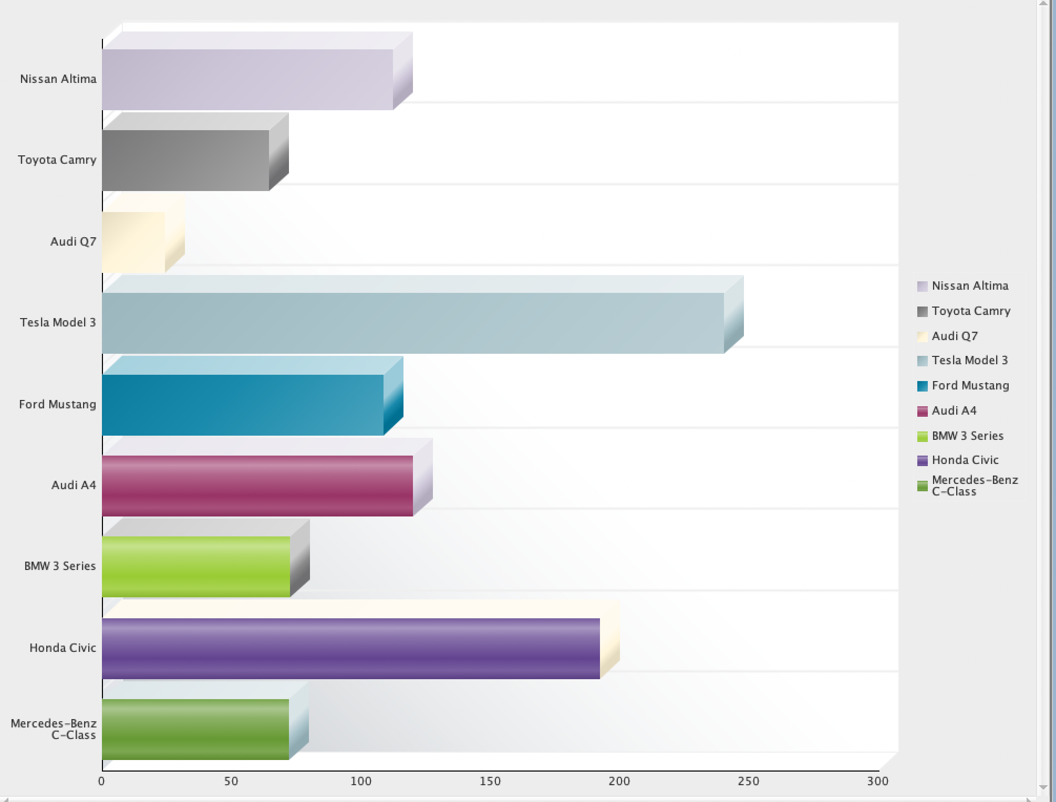
Most Favoured car Report:

Slide 15
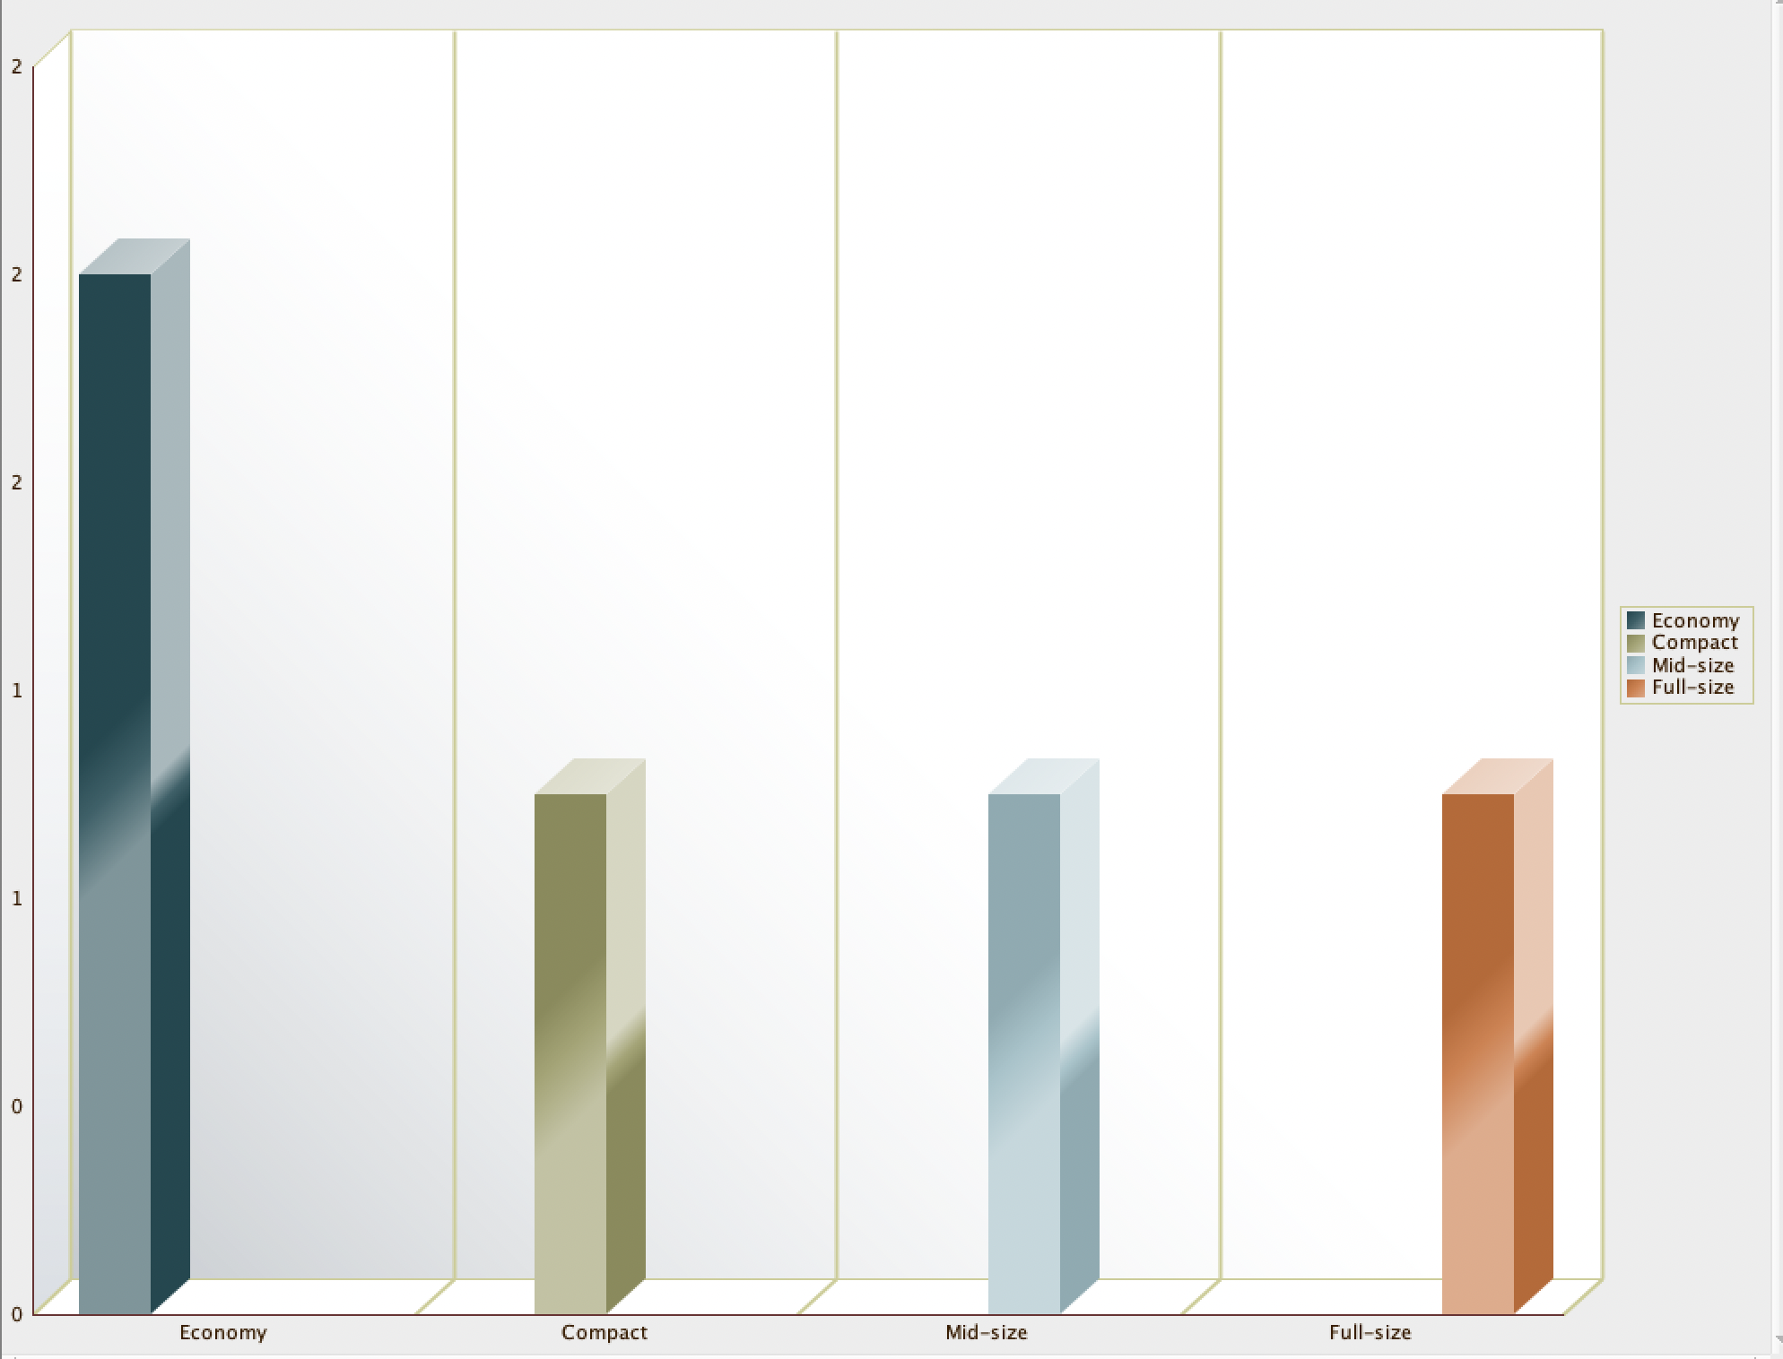
Most favoured car type:

Slide 16
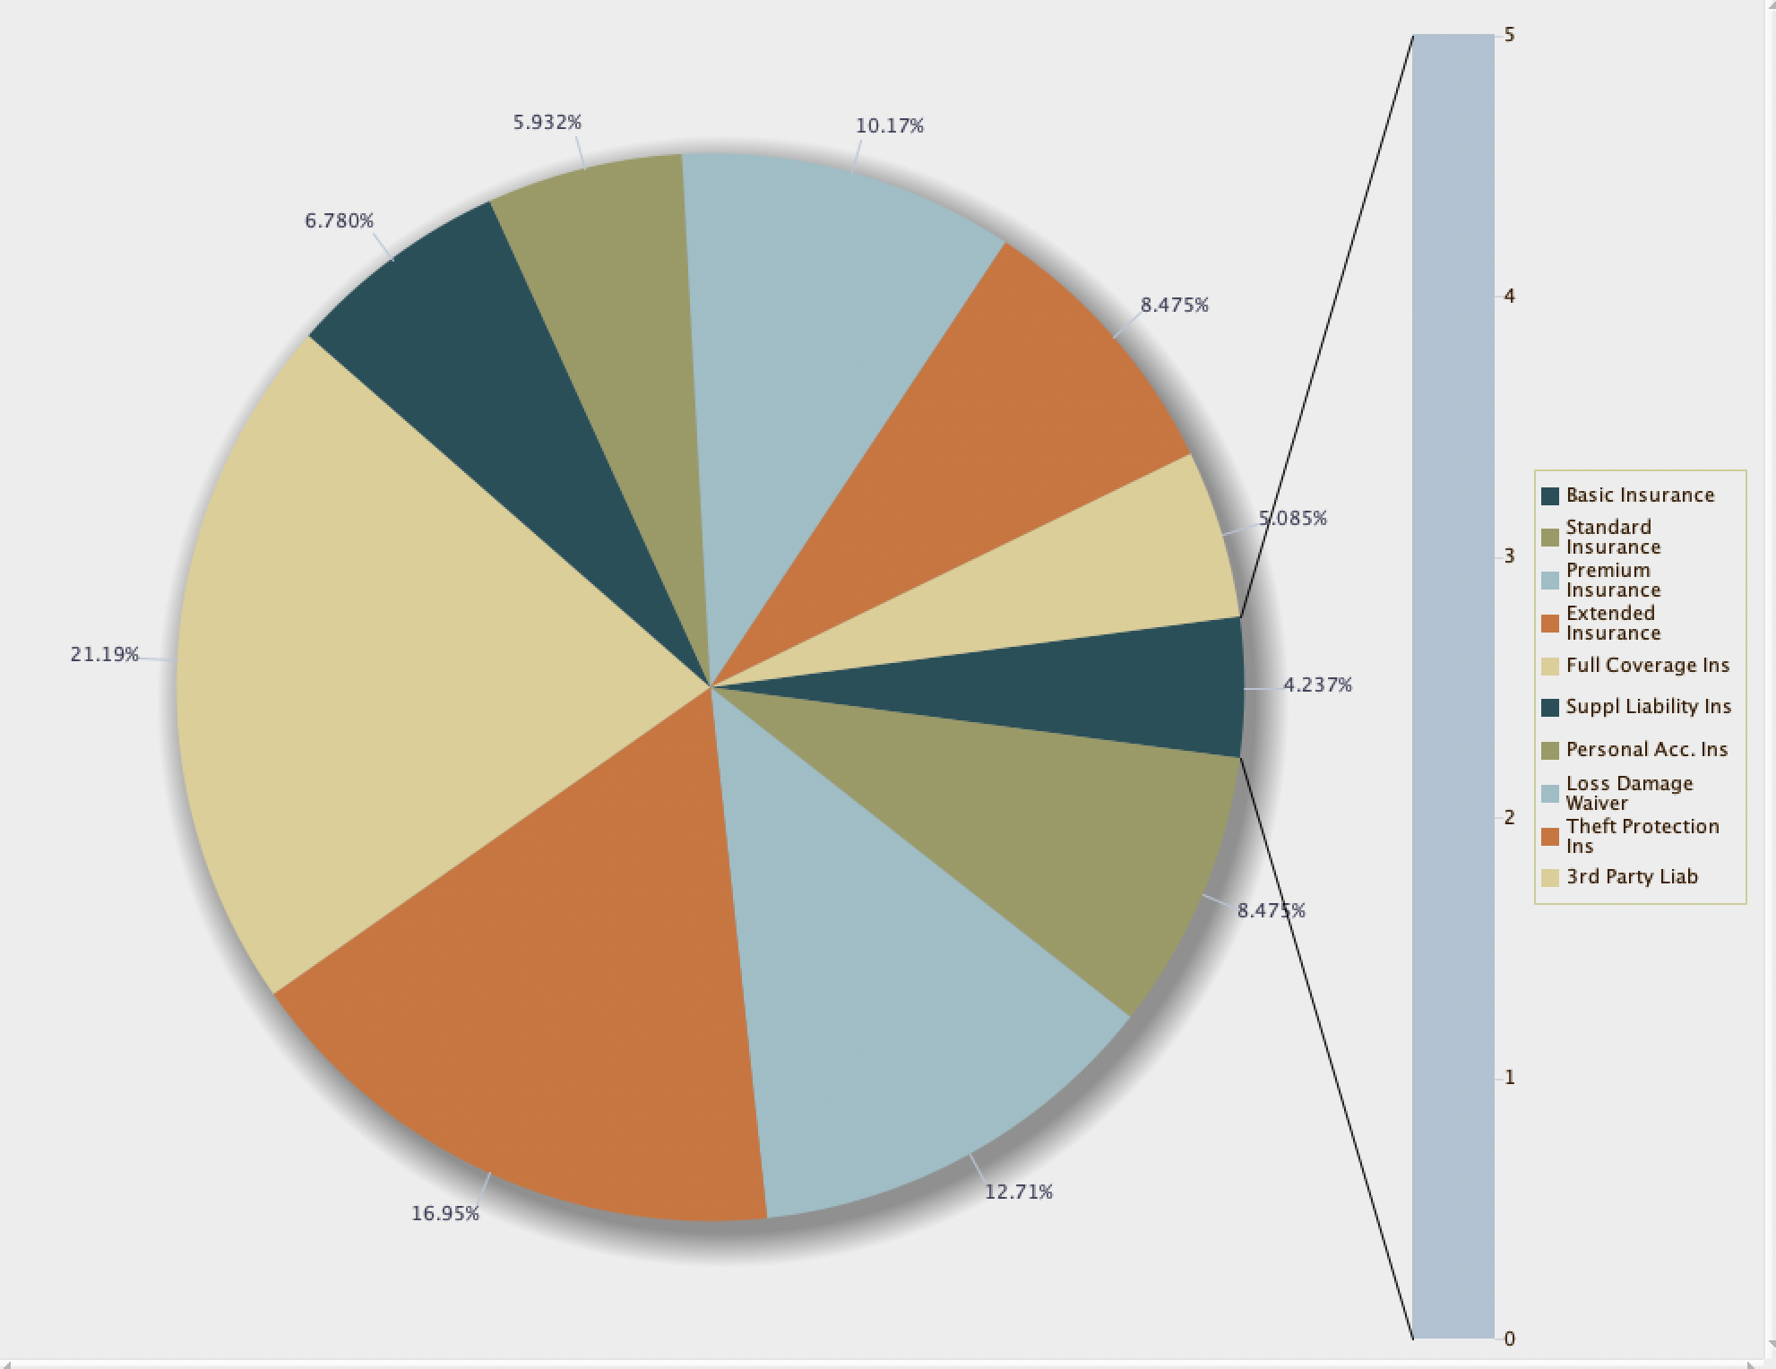
Insurance Coverage Report :
It provides a summary of the offered insurance and it’s coverage.

Slide 17
Contribution:
Anushka Rajesh Darade - DFD 0, DFD 1, DFD 2, Procedures, ERD: car_rental_insurance, damage
Harish Kumar Vaithyan Nandhagopu - DFD 0, DFD 1, DFD 2, packages,views,ERD: CARS,LOCATION
Barathi Sridhar: Procedure,Functions, ERD: Booking, Discount
Sudharsan Ragavendhiran Anuradha: Views,Reports,ERD: Billing, Customer
Karthik Prakash: Triggers,Procedures ERD: Review, Car_Category

Slide 18
Thank you!

